Slide 1
Strategic Marketing Simulator 1.0 Sprint 2 review
Strategic Marketing Simulator 1.0
Team # 15
Team Members
Jeffrey Carman
Javier Andrial
Product Owner: Joseph Cilli
Project Mentor: Masoud Sadjadi

Slide 2
Introduction
Simulation of hotel sales market
Groups
Strategic Decisions
Accountability
Administration

Slide 3
Sprint 2 Stories – A summary
Carried over from sprint 1:
Account Creation
Email Account Verification (pending)
Login
New to sprint 2:
Forgot my password
Email password reset (pending)

Slide 4
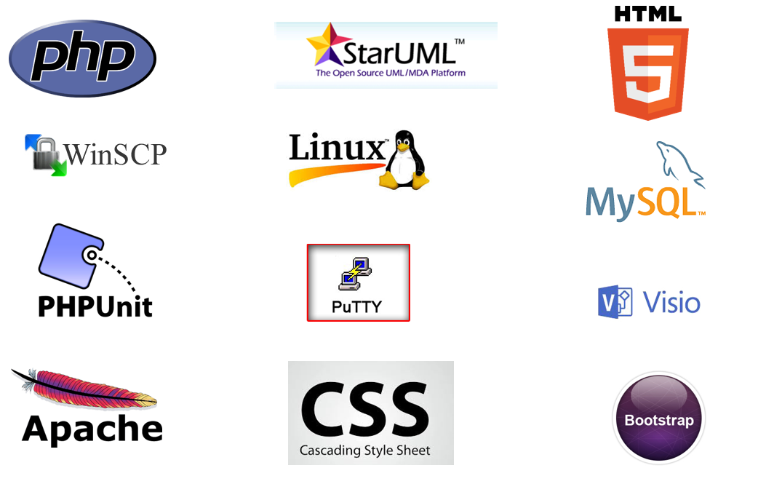
Introduction

Slide 5
User stories – recap unfished from Sprint 1
User Story # 666- Account Creation
Tasks
Insert database tables for users, groups, and courses (database subsystem).
Setup blank home page with login link.
Setup login page (username, password text boxes; “forgot my password”, “new user” links; and login button.
Setup account creation webpage (username, password, PID, email text boxes; and a list of courses available.
Setup PHP class user with getter/setter methods and boolean value for isAdmin.
Setup PHP Database class and methods for updating user and group tables of the database subsystem
write scripts to tie it all together

Slide 6
User stories
User Story # 669- User login
Tasks
Add methods to PHP Database class for user login.
write scripts to communicate with to Database subsystem from front end.
write scripts to navigate user to homepage upon success.
Appropriate error message upon value.
(Future release should have account lockout policy)

Slide 7
User stories – Sprint 2
User Story # 667- Forgot my password
Tasks:
The user clicks on the “forgot my password” link from the login page.
The system generates a random temporary password.
The system sends the use an email with his or her temporary password enclosed.
The user logs onto the system using the temporary password.
The system requires that the user reset his password by entering it in two text boxes.
The user’s password is reset.

Slide 8
User stories – use case modeling
Use Case 5 – Forgot my password
Actor:
Student
Pre-Conditions:
Student forgets his or her password
Normal Course:
1. Student navigates to forgot my password page
2. Student enters email or PID in text box
3. Use clicks on “find my account” button
4. The user then answers the security question
5. Student enters new password in text box
6. Student presses “change my password” button
7. Students Password has been changed
Alternative Course:
Student email did not match
Student will have to repeat step 2
Student secret Answer did not match
Student will have to repeat from step 1
Student did not enter a valid password
Student will have to repeat step 5
Post Conditions:
Student was successful
Student has a new pass word and can log into the system.
Student was unsuccessful
The Student will have to repeat from step 1

Slide 9
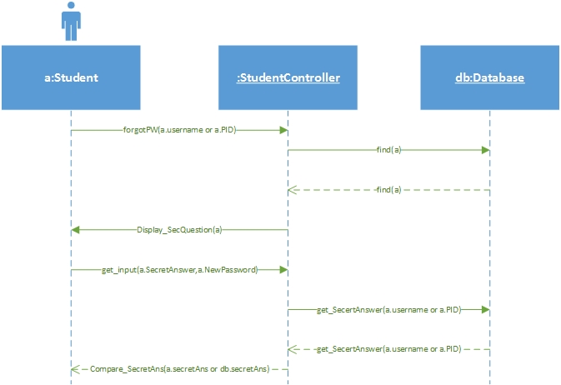
Forgot my password sequence diagram

Slide 10
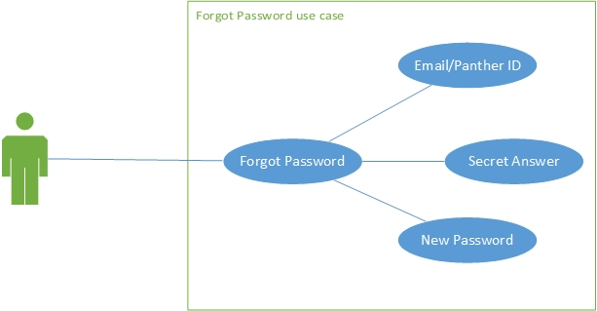
Strategic Marketing Simulator 1.0

Slide 11

Software Testing
Unit Testing
PHPunit
PHPunit.xml
Listener Class

Slide 12
Software Testing – Assertions
public function test_getStudentNotFound()
{
$db = new database();
return $this->assertEquals(count($db->getStudent("stickle")), 0);
}
/**
* @covers a
*/
public function test_addStudent()
{
$db = new database();
return $this->assertEquals($db->addStudent(1651548, "rickly", "roberts", "Rickle@roberts.com", 0, 1263481, "where am I", "everywhere"), null);
}

Slide 13
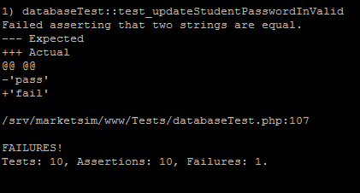
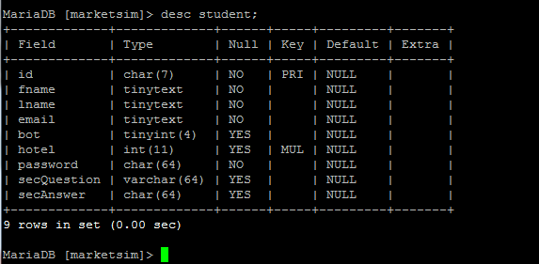
Software Testing – DB test failure
public function test_updateStudentPasswordInValid()
{
$email = "jcarm012@fiu.edu";
$db = new database();
$this->assertEquals($db->updateStudentPassword($email, NULL), "fail");
}

Slide 14
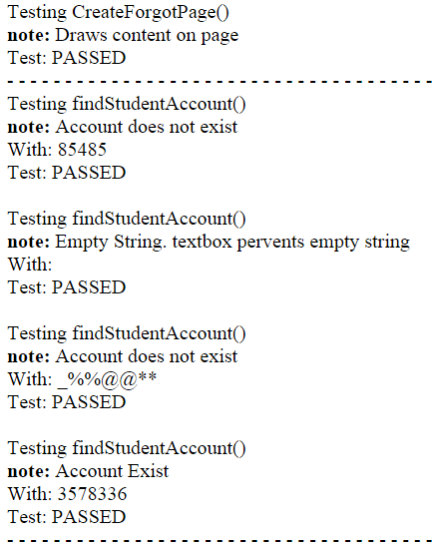
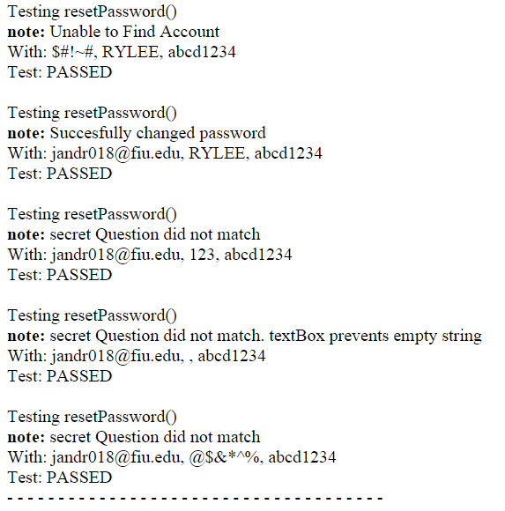
Software Testing – Forgot Password

Slide 15
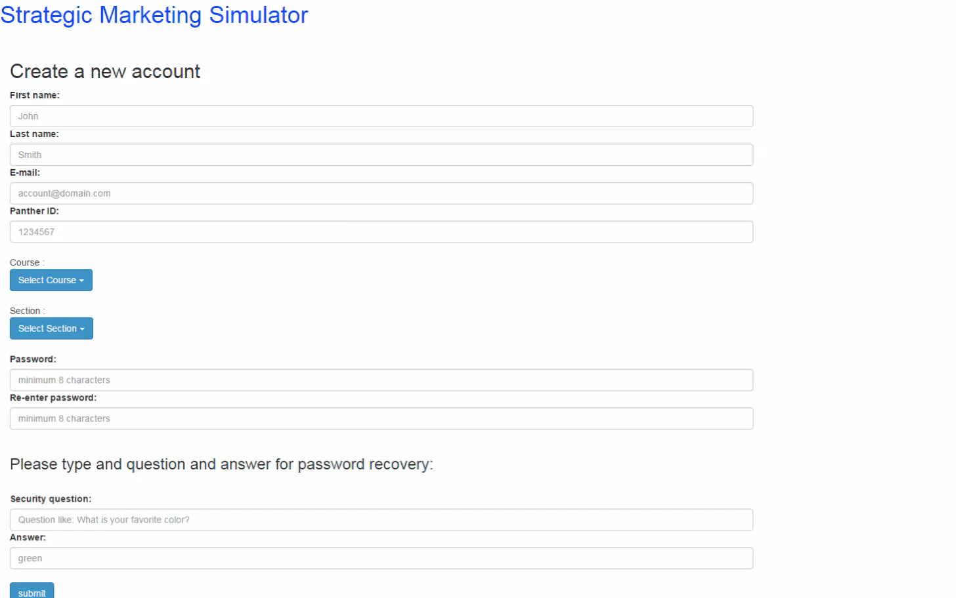
Demo – Create an account

Slide 16
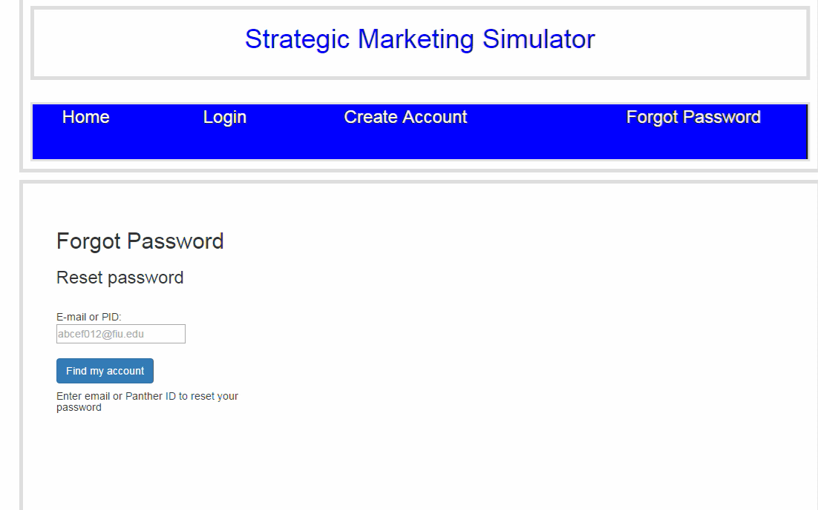
Demo – Forgot Password

Slide 17
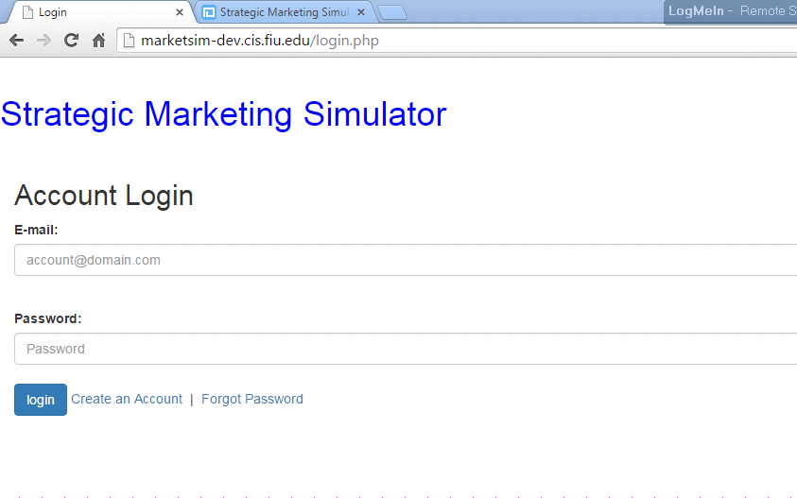
Demo - Login

Slide 18
Problems:
Learning curve - Esthetics
Email Server

Slide 19
Strategic Marketing Simulator 1.0
Questions?

